Slide 1



Counterfactual Regret Minimization
May 13, 2021

Slide 2
Agenda
Why counterfactual regret minimization (CFR) is used
What CFR does – high level
Background on regret
Upper confidence bound
Regret matching
How does CFR work
Extensions to CFR
Discussion

Slide 3
Why CFR
Counterfactual Regret Minimization (CFR) is a technique for iteratively approximating Nash equilibrium strategies for complex imperfect information games
Imperfect information games are different from perfect information games because the value of actions is dependent upon the opponent’s policy
Imperfect information games are also very high dimensional, which further complicates solving them

Slide 4
What does CFR Do
CFR is an extension of Regret Matching which goes beyond normal-form imperfect information games where each player only has one turn, and works for extensive-form, sequential imperfect information games where there is a series of back and forth turns
CFR approximates the optimal strategy for a given position by examining the subtree of possible actions from the current state down to terminal states
The big trick is to decompose overall regret into a set of additive regret terms, which can be minimized independently
It minimizes a new form of regret for each information set separately

Slide 5
Background on Regret
Regret is defined as the difference between the reward/utility received from a single action and the (mixed) strategy employed
Positive regrets are where the action was better
Regret minimization is a common technique, and there are proofs that the minimum regret = Nash equilibrium = optimal
Note that the minimum regret does not need to go to zero
For the multi-armed bandits problem, the Upper Confidence Bound algorithm is based on regret minimization

Slide 6
Regret Matching
The Regret Matching algorithm can be used for normal-form imperfect information games, e.g. rock-paper-scissors
Hart and Mas-Colell (2000)
Iterative algorithm where you choose random actions
Keep a cumulative sum of all positive regrets for the action (negative regrets are ignored)
Note tracking the cumulative sum is basically the same as tracking the mean, since we just need to divide by the number of iterations
The optimal mixed strategy is obtained by normalizing the cumulative regrets so that they sum to one, and using those as action probabilities
We use the mean, not use the last iteration. This is not a case of convergence.
CFR extends this to work on subtrees with multiple moves

Slide 7
How does CFR Work
CFR differs from regret matching in a few ways (as I understand):
Instead of just one opponent action, we now have a subtree of multiple back and forth actions following certain strategies. We recursively calculate the regret coming from each terminal state, and now we must multiply all of these regrets by their reach probability.
We run CFR tree traversal from the perspective of a particular player. For this player, we pretend as if they acted with probability 1 to get to this history.
This is not true, so this is where the counterfactual part of the name comes from
I think this is done to reduce the dimensionality so that CFR will converge faster
CFR is run for every information set
When running CFR, you take turns running it for each player

Slide 8
How does CFR Work
Over many iterations, the regrets we sum up for all of the possible actions are not regular regrets (because of the probabilities of one that we faked). Instead these are called immediate counterfactual regrets.
Counterfactual regret minimized for every information set is proven to be an upper bound on regret
Therefore, if you minimize counterfactual regret to zero, then you have minimized regret to zero
In developing a mixed strategy by minimizing counterfactual regret (and regret), we have approximated the Nash equilibrium
CFR is able to solve problems a couple orders of magnitude larger than before
I believe this is compared to Fictitious Play

Slide 9
CFR Algorithm
For each simulated game, MCCFR chooses one player (whom we refer to as the traverser) that will explore every possible action and update his regrets, while the opponent simply plays according to the strategy determined by the current regrets. The algorithm switches the roles of the two players after each game, that is, a single hand of poker. Every time either player is faced with a decision point in a simulated game, the player will choose a probability distribution over actions on the basis of regrets for those actions (which are determined by what he had learned in earlier games when he had been in that situation). For the first game, the AI has not learned anything yet and therefore uses a uniform random distribution over actions. At traverser decision points, MCCFR explores every action in a depth-first manner. At opponent decision points, MCCFR samples an action on the basis of the probability distribution. This process repeats at every decision point until the game is over and a reward is received, which is passed up. When a reward is returned by every action at a traverser decision point, MCCFR calculates the weighted average reward for that decision point on the basis of the probability distribution over actions. The regret for each action is then updated by adding the value returned by that action and subtracting the weighted average reward for the decision point. The weighted average reward is then passed up to the preceding decision point, and so on.

Slide 10
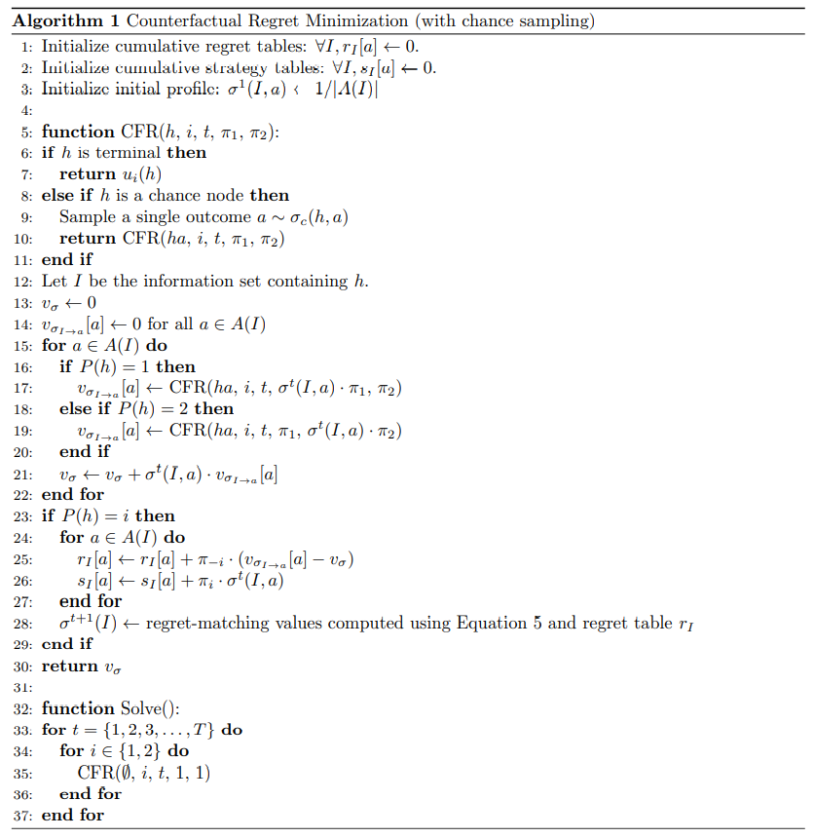

Slide 11
Extensions to CFR
The original CFR algorithm has been improved/extended in various ways, including:
Depth-limited
Sampling
CFR+ weights more recent policies heavier
Monte Carlo CFR

Slide 12


